Slide 1
2
Numerical Methods
Techniques to obtain approximate solutions to mathematical problems, Used when:
Exact (analytical) solutions do not exist
Exact solutions are too complex to derive
Computers are required for fast results
Provide efficient, practical answers with controlled accuracy.

Slide 2
Why Do We Need Numerical Methods?
3
Many real-world problems are nonlinear, complex, or unsolvable analytically. Physical systems often lead to equations with:
No closed-form solutions
Very large datasets
Multivariable complexity
Numerical methods allow us to:
Model
Simulate
Optimize
engineering and scientific systems

Slide 3
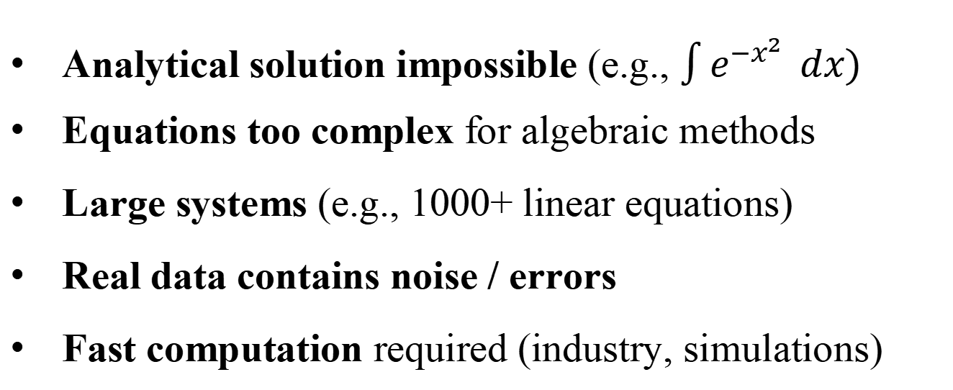
4
Major Reasons for Using Numerical Methods
Analytical solution impossible (e.g., $\int{e^{−x^{2}}} dx)$
Equations too complex for algebraic methods
Large systems (e.g., 1000+ linear equations)
Real data contains noise / errors
Fast computation required (industry, simulations)

Slide 4
5
Applications of the Topic
Engineering: stress analysis, structural design, power system analysis.
Physical sciences: astronomy, Schrödinger equation solutions.
Finance: option pricing, forecasting, risk analysis.
Medical imaging: CT/MRI reconstruction algorithms.
Computer graphics: rendering, animation, image processing.

